Slide 1
50.001 Lesson 4/5

Slide 2
Agenda
Recall Strategy Design Pattern
Recall Adapter Pattern
RecyclerView is a combination of both
Recall Observer Pattern

Slide 3
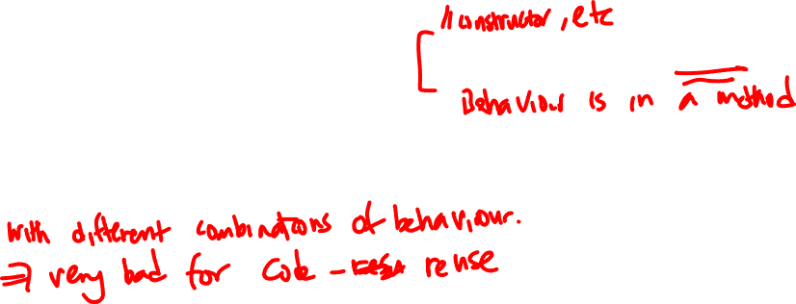
Problem
If you had to change the way the bird flies, you would have to inherit and override.
Then if you had to do it often, then you would have a lot of different Bird classes.
public class Bird { public void fly(){ System.out.println("I CAN fly"); } }

Slide 4
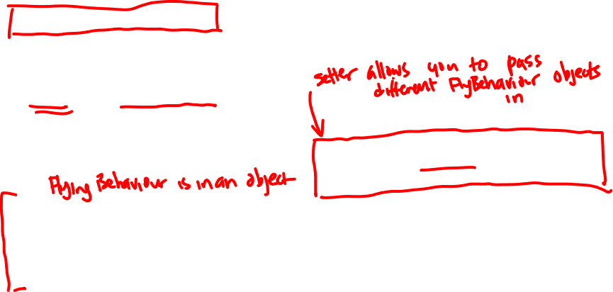
Solution – Strategy Design Pattern
Encapsulate what varies – encapsulate the flying behaviour in separate objects.
Delegation - The flying behaviour is delegated to FlyBehaviour objects.
public interface FlyBehaviour { void doFly(); }
public class CanFly implements FlyBehaviour{ @Override public void doFly() { System.out.println("I CAN fly"); }
If you had to change the way the bird flies, simply write and pass a new FlyBehaviour object in.
public class Bird { private FlyBehaviour flyBehaviour; public void setFlyBehaviour( FlyBehaviour flyBehaviour){ this.flyBehaviour = flyBehaviour; } public void fly(){ flyBehaviour.doFly(); } }

Slide 5
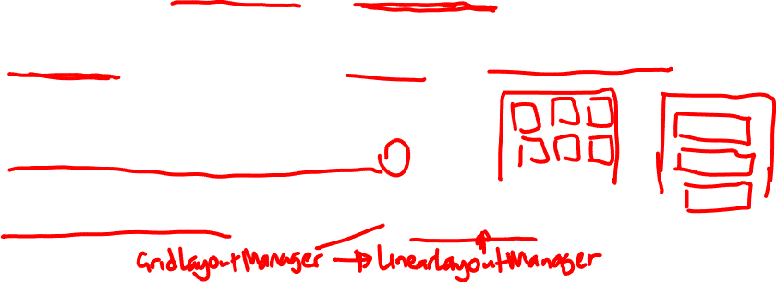
RecyclerView Code in MainActivity.java
charaAdapter = new CharaAdapter(this, dataSource);
recyclerView.setAdapter( charaAdapter);
recyclerView.setLayoutManager( new GridLayoutManager(this, 3) );
Strategy Design Pattern -
The data+layout for the list items is delegated to RecyclerView.Adapter objects
Strategy Design Pattern -
The display of the list items is delegated to LayoutManager objects

Slide 6

Problem
import java.util.ArrayList; public class Adapter { public static void main(String[] args) { List<Duck> duckArrayList = new ArrayList<>(); } } interface Duck{ void quack(); } interface Turkey{ void gobble(); }
If you are expecting objects of type A, how do you accept objects of type B? ( B is not related to A but have similar information that you want)
You have a List<> of Duck, how do you get it to accept Turkey objects?

Slide 7
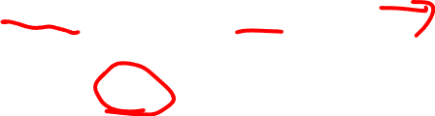
Solution – Adapter Pattern
import java.util.ArrayList; public class Adapter { public static void main(String[] args) { List<Duck> duckArrayList = new ArrayList<>(); } } interface Duck{ void quack(); } interface Turkey{ void gobble(); }
public class TurkeyAdapter implements Duck{
private Turkey turkey;
TurkeyAdapter(Turkey turkey){
this.turkey = turkey; } public void quack(){
turkey.gobble();
} }
You have a List<> of Duck, how do you get it to accept Turkey objects?

Slide 8
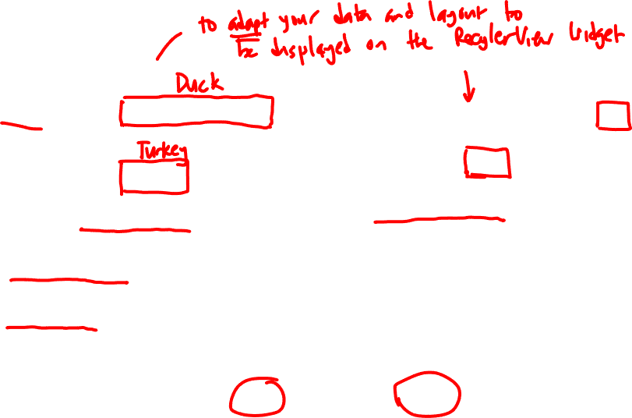
CharaAdapter
public class CharaAdapter extends RecyclerView.Adapter<…> { Context context; LayoutInflater mInflater; DataSource dataSource; CharaAdapter(Context context, DataSource dataSource){ } @NonNull @Override public CharaViewHolder onCreateViewHolder(…) { // inflate the layout of each item } @Override public void onBindViewHolder(…) { // put the data on each list item layout } @Override public int getItemCount() { return dataSource.getSize(); }
public class TurkeyAdapter implements Duck{
private Turkey turkey;
TurkeyAdapter(Turkey turkey){
this.turkey = turkey; } public void quack(){
turkey.gobble();
} }
Question: in CharaAdapter, which class is Duck? Which class is Turkey?

Slide 9
Contingencies for Exam
Because there are several single point of failures in our setup:
Final Exam Part 1. You (or everyone) could be asked to write programming code on paper for Java objects if you can't login to Schoolyear.
In such a situation, grading will not disadvantage you. The grader knows that you can't compile your code and will grade accordingly.
Final Exam Part 2. If you can't launch the Lockdown Browser, you write your answers on paper at no disadvantage to you.

Slide 10
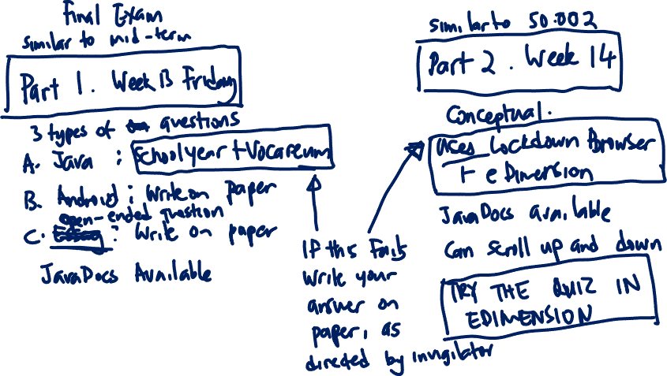

Slide 11
Lesson 5 – Firebase + Observer Pattern

Slide 12
The Firebase API is not tested but remind you that the Observer pattern is included in the scope of topics to be tested

Slide 13
How to use the Firebase Realtime database
https://firebase.google.com/docs/database/android/start Also see Lesson 5 pdf.
Create your database at console.firebase.google.com
Follow the instructions to add your app and the process ends with a google-services.json that must be placed in the /app folder.
Update the gradle files with the necessary libraries.

Slide 14
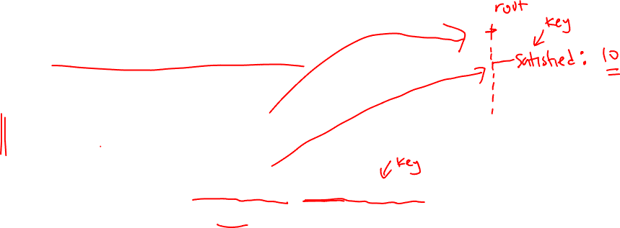
How to use the Firebase Realtime Database Java Library - Examples
Get a reference to the root node of the database and use it to get a reference to any child node by specifying the key.
DatabaseReference mRootDatabaseRef = FirebaseDatabase.getInstance().getReference(); DatabaseReference mNodeRefSatisfied
= mRootDatabaseRef.child("satisfied");
Note that, when calling .child(), if the key specified does not exist, a child node will be created

Slide 15
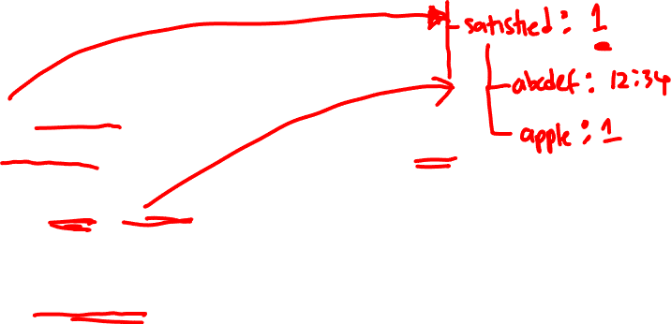
How to use the Firebase Realtime Database Java Library - Examples
2. To update the value of any specific node, use the reference with the setValue() method.
mNodeRefSatisfied.setValue(1);
3a. To create child nodes with random keys, use the push() method
mNodeRefSatisfied.push().setValue(timestamp.toString());
3b. To create child nodes with the key you want, use the child() method
mNodeRefSatisfied.child(”apple").setValue(1);

Slide 16
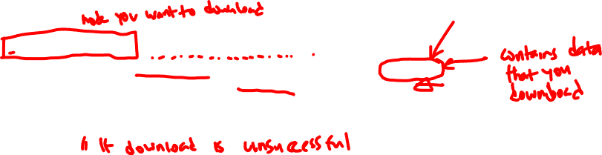
How to use the Firebase Realtime Database Java Library - Examples
4. To download data from a node, which could be a single value or a list of references to child nodes, use addValueEventListener().
The data is stored in the DataSnapshot object, which you can then call methods on.
Recall that you need to put such downloading tasks in the background thread. This code handles that for you and thus you do not need to write code explicitly for threads. mNodeRefSatisfied.addValueEventListener(new ValueEventListener() { @Override public void onDataChange(@NonNull DataSnapshot snapshot) { // extract data from snapshot and handle it } @Override public void onCancelled(@NonNull DatabaseError error) { } });

Slide 17
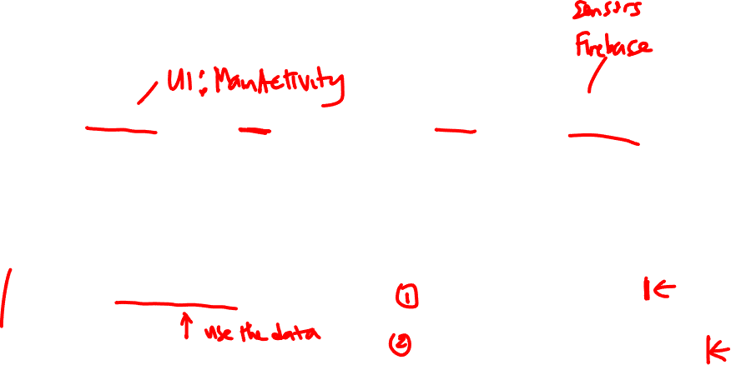
Recall the Observer Pattern
The Observer is the user of data and would have one method to execute when it receives the data.
public interface Observer{ void update(double data); }
The Subject is the source of data and will need (1) to hold reference to the Observer object(s) (2) notify the Observer when data is changed
public interface Subject { void register(Observer o); // come to me if you want data void unregister(Observer o); void notifyObservers(); // when I get data I will tell you }

Slide 18

Use the Observer Pattern with Firebase
Since Observer is the user of data, make MainActivity implement Observer and say what you want to do with the data in the update() method.
public interface Observer{ void update(DataSnapshot dataSnapshot); }
Since Subject is the source of data, write a class that implements Subject and has the Firebase download code. Interface is modified slightly.
public interface Subject { void register(Observer o); // come to me if you want data void downloadToObserver(); // when I get data I will tell you }
Design Patterns shown to you are not cast in stone but can be modified to suit your app’s circumstances.

Slide 19
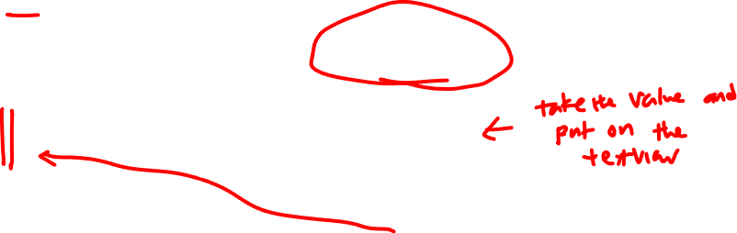
Use the Observer Pattern with Firebase
Since Observer is the user of data, make MainActivity implement Observer and say what you want to do with the data in the update() method. Example:
public class MainActivity extends … implements Observer{ // other code void update(DataSnapshot dataSnapshot){ textView.setText( dataSnapshot.getValue() ); } }
public interface Observer{ void update(DataSnapshot dataSnapshot); }

Slide 20
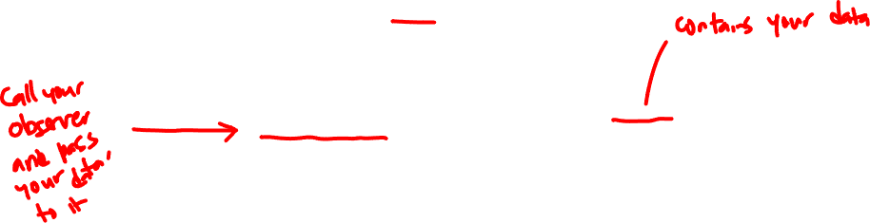
Use the Observer Pattern with Firebase
Since Subject is the source of data, write a class that implements Subject and has the Firebase download code. Example.
public class FirebaseDL implements Subject { void register(Observer o){ … } // setter method void downloadToObserver(){
mNodeRefSatisfied.addValueEventListener(new ValueEventListener() { @Override public void onDataChange(@NonNull DataSnapshot snapshot) { o.update(snapshot); // call the Observer’s method } @Override public void onCancelled(@NonNull DatabaseError error) { } }); } }
public interface Subject { void register(Observer o); void downloadToObserver(); }
public interface Observer{ void update(DataSnapshot dataSnapshot); }

Slide 21
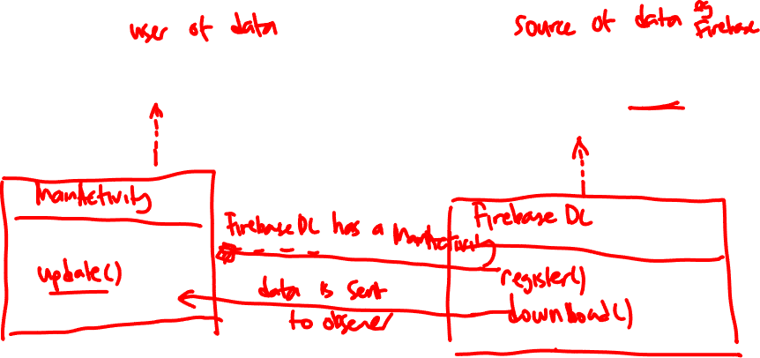
Use the Observer Pattern With Firebase
public interface Observer{ void update(DataSnapshot dataSnapshot); }
public interface Subject { void register(Observer o); void downloadToObserver(); }

Slide 22
Other reminders
Firebase Storage is for you to store images. The Java API is similar.
In the Lesson 5 example repo, not all the code is optimized to show good design principles. → So, read the code to learn how to upload /download images to Firebase Storage but think about how to improve them for better design.

Slide 23
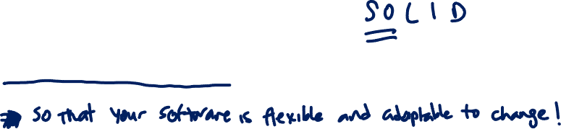
Big Ideas in this course
Loosely couple your classes by making them depend on / implement interfaces or abstract classes instead of concrete classes. The design patterns show you how for standard problems. ➔ if you have to deal with new requirements / implementations, write a new class!

